Slide 1
Chapter 2
The Basic Concepts of Set Theory
Section 2-2
Venn Diagrams and Subsets

Slide 2
Objectives - Venn Diagrams and Subsets
Use Venn diagrams to depict set relationships.
Determine the complement of a set within a universal set.
Determine if one set is a subset of another.
Understand the distinction between a subset and a proper subset.
Determine the number of subsets of a given set.

Slide 3
Venn Diagrams
In set theory, the universe of discourse is called the universal set, typically designated with the letter U. The universal set includes ALL the elements of ALL the sets, and perhaps all the elements NOT in all the sets (involved in the situation).
Venn Diagrams were developed by the logician John Venn (1834 – 1923). In these diagrams, the universal set is represented by a rectangle and other sets of interest within the universal set are depicted as circular regions.

Slide 4
Venn Diagrams
The rectangle represents the universal set, U, while the portion bounded by the circle represents set A.
A
U

Slide 5
Complement of a Set
The shaded region inside U and outside the circle is labeled A' (read “A prime”). This set, called the complement of A, contains all elements that are contained in U, but not in A.
For any set A within the universal set U, the complement of A, written A', is the set of all elements of U that are not elements of A. That is:
A
U

Slide 6
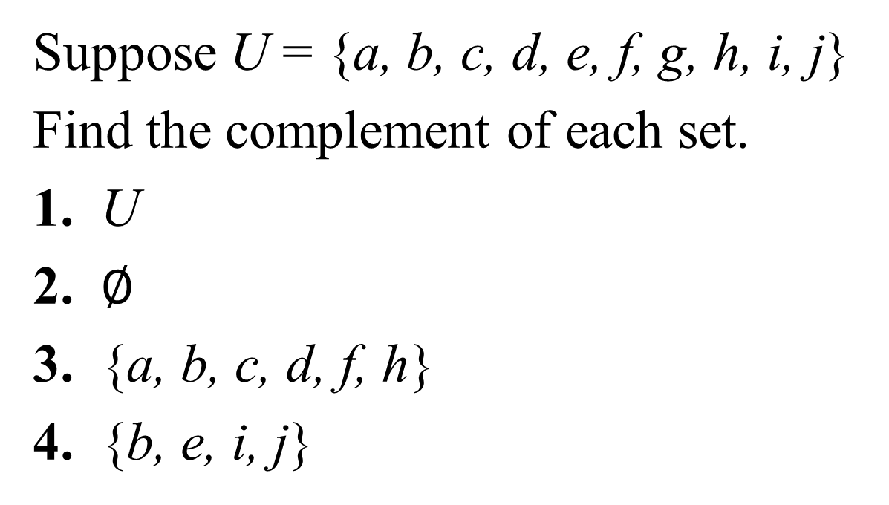
Complement of a Set -- Example
Suppose U = {a, b, c, d, e, f, g, h, i, j}
Find the complement of each set.
1. U
2. $∅$
3. {a, b, c, d, f, h}
4. {b, e, i, j}

Slide 7
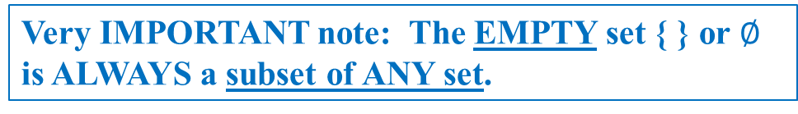
Subsets of a Set
Set A is a subset of set B if every element of A is also an element of B. In symbols this is written
B
That symbol means “is a subset of”
A
U
Very IMPORTANT note: The EMPTY set { } or $∅$ is ALWAYS a subset of ANY set.

Slide 8
Example: Determining If One Set Is a Subset of Another
Fill in the blank with to make a true statement.
a) {a, b, c} ___ { a, c, d}
b) {1, 2, 3, 4} ___ {1, 2, 3, 4}
Solution
a) {a, b, c} ___ { a, c, d}
b) {1, 2, 3, 4} ___ {1, 2, 3, 4}
Think of a subset as meaning
“is contained within”

Slide 9

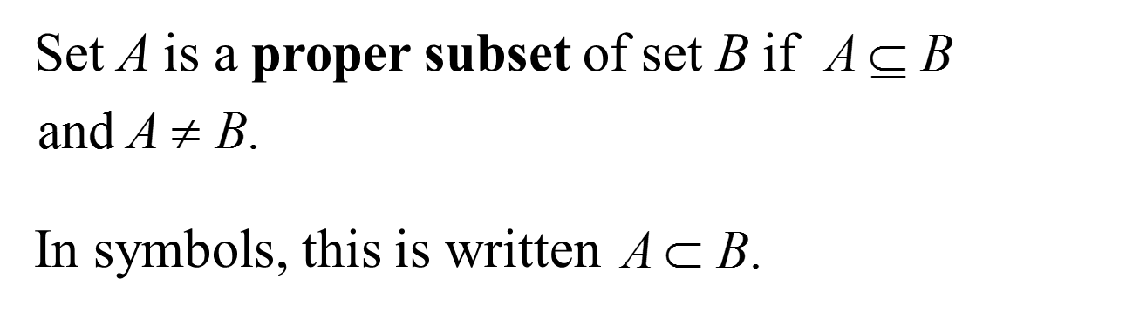
Set Equality (Alternative Definition)
Suppose that A and B are sets. Then A = B if
That symbol means “is a proper subset of”

Slide 10
Example: Determining Subsets and Proper Subsets
Decide whether or both could be placed in each blank to make a true statement.
a) {a, b, c} ___ { a ,b, c, d}
b) {1, 2, 3, 4} ___ {1, 2, 3, 4}
Solution
a) both
b)

Slide 11
Counting Subsets
One method of counting subsets involves using a tree diagram. The figure below shows the use of a tree diagram to find the subsets of {a, b}.
Yes
No
{a, b}
{a}
{b}
Yes
No
Yes
No

Slide 12
Number of Subsets
** NOTECARD INFO !! ** Formulas, page 57
The number of subsets of a set with n elements is 2^{n}.
The number of proper subsets of a set with n elements is 2^{n} – 1.

Slide 13
Example: Finding Numbers of Subsets and Proper Subsets
Find the number of subsets and the number of proper subsets of the set {m, a, t, h, y}.
Solution
Since there are 5 elements, the number of subsets is 2⁵ = 32.
The number of proper subsets is 32 – 1 = 31.

